Slide 1

9 Management Habits Quietly Burning Out Your Best Engineers
Presented By :
Andrew Murphy
debuggingleadership.com

Slide 2

Why are we talking about this?
What are the 9 habits?
What do we do about it?
Q&A

Slide 3
This isn’t a monologue.
Interruptions are expected and even encouraged.

Slide 4
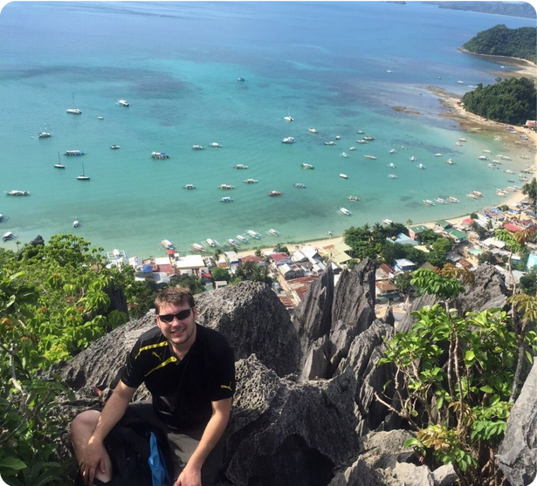
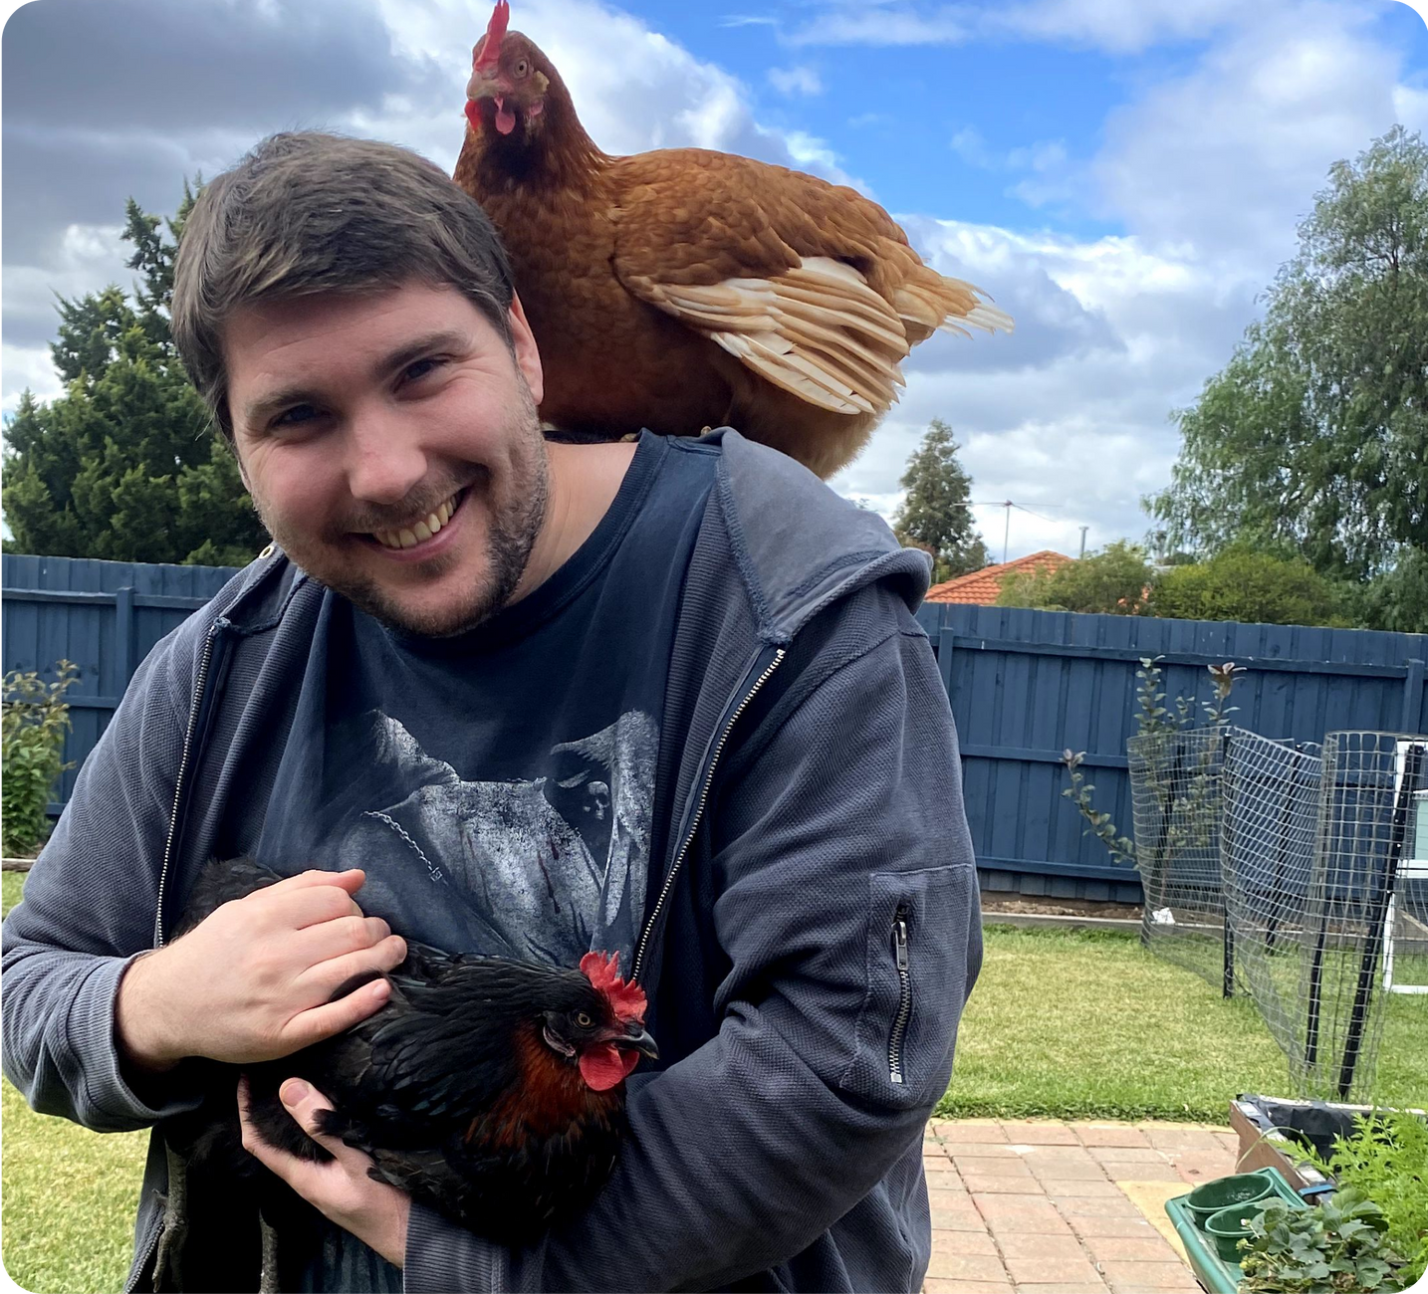


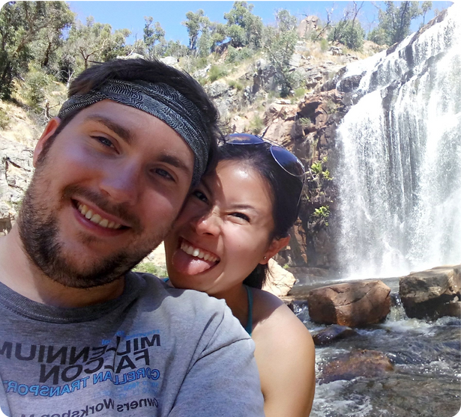

Slide 5


Slide 6
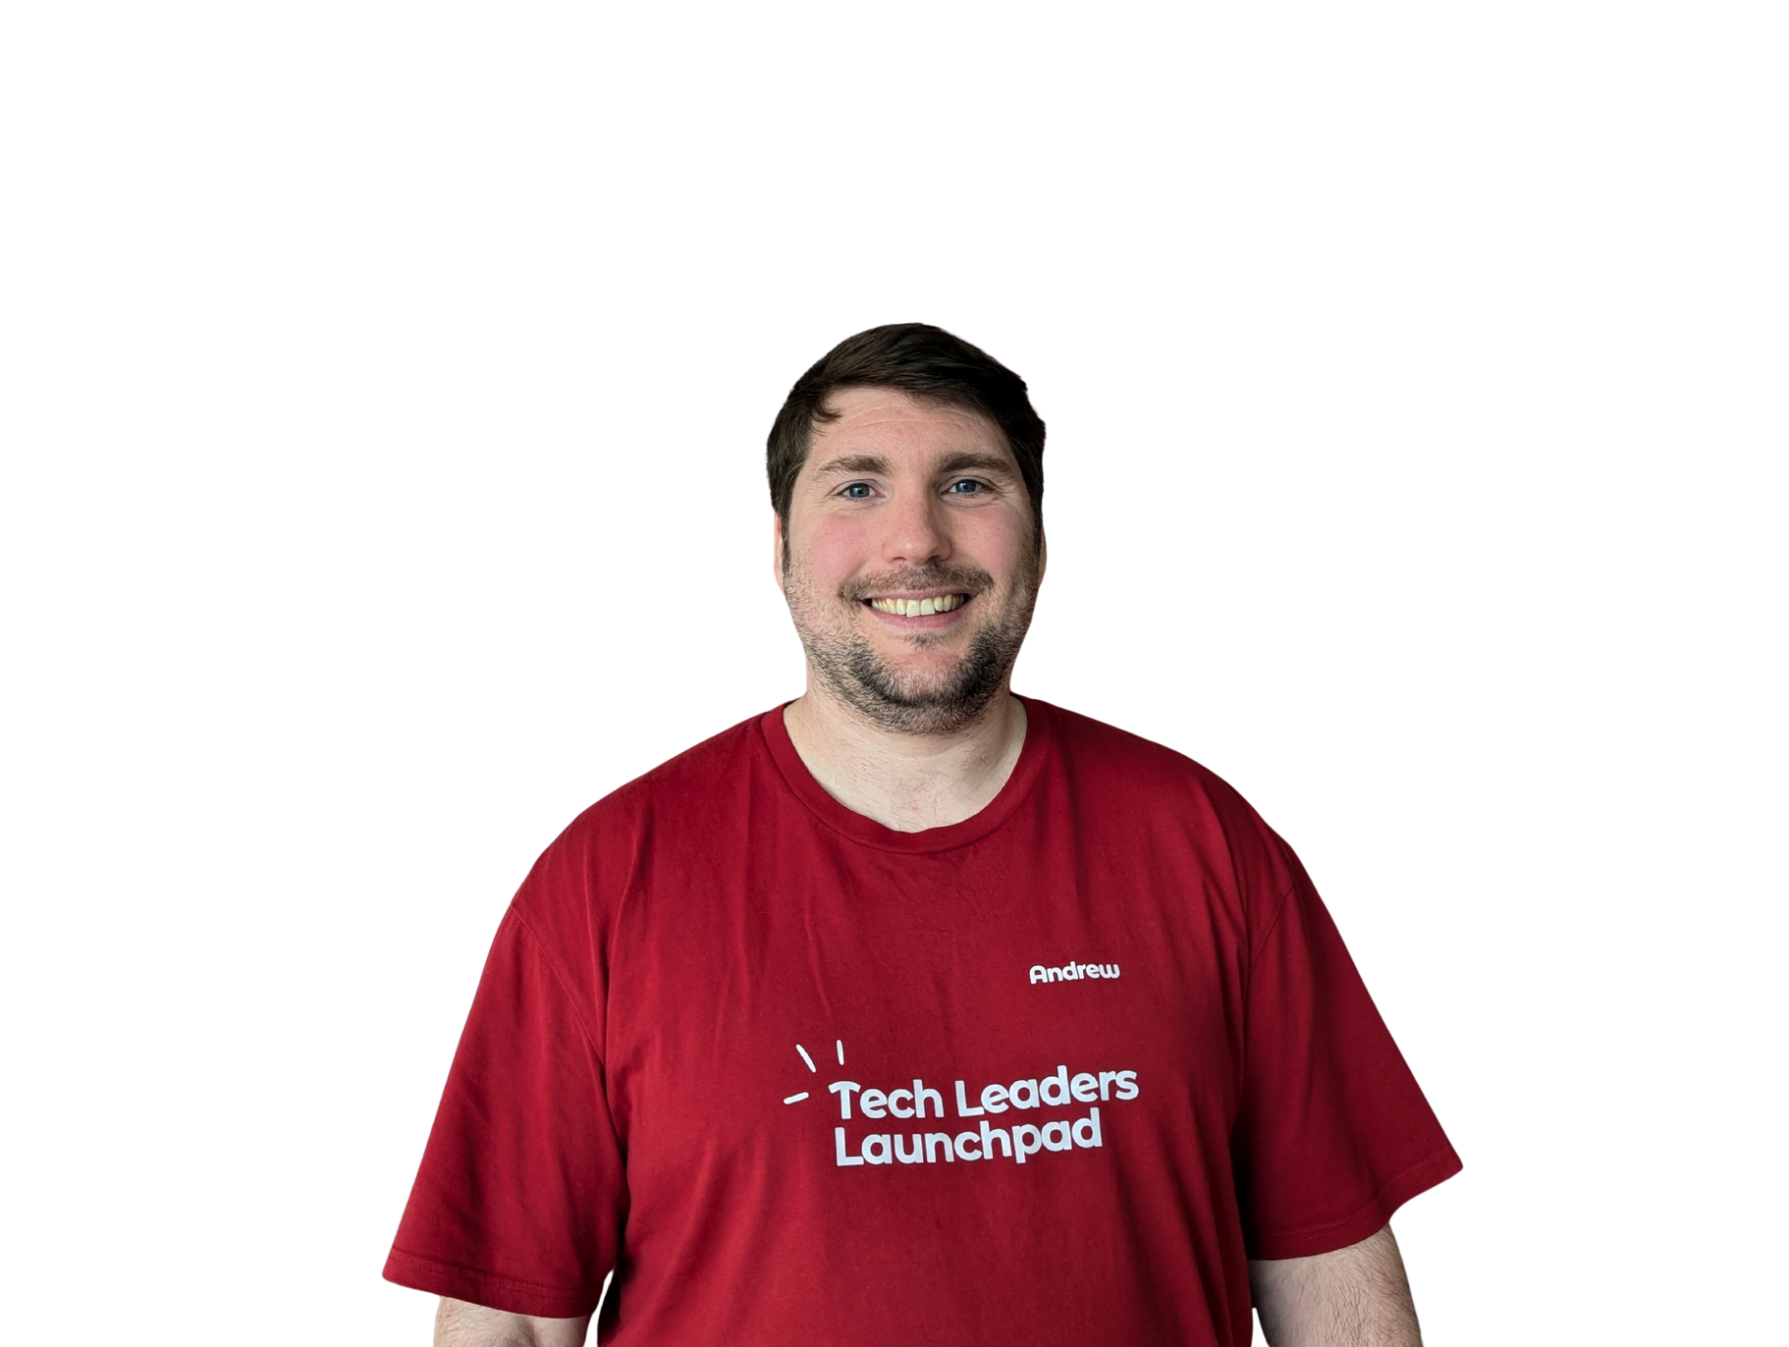
My Career:
Coder
~25 years
Tech leader
~17 years
Trainer (TLL)
~7 years
Debugging Leadership
~NEW!

Slide 7
Burnout in engineering teams is rarely caused by a single event

Slide 8
Persistent habits that quietly erode motivation, well-being, and performance

Slide 9
What is burnout?

Slide 10
The 9 Habits:

Slide 11

1.
Equating Busyness With Value
Try to measure and reward impact, not activity.
Implement weekly "impact reviews" where developers showcase one meaningful contribution rather than listing all activities

Slide 12

2.
Failing to Set, Respect
and Model Healthy Boundaries
Model healthy boundaries and encourage your team to disconnect after hours.
Use different channels/tools for different urgency levels

Slide 13

3.
Promotion Paradox: Rewarding Crisis Over Consistency
Change promotion criteria to value preventive impact equally with incident response.
Create "impact portfolios" to document how preventive work avoided potential issues

Slide 14

4.
Overloading Top Performers
Distribute workload fairly and rotate responsibilities.
Recognize and reward contributions openly.
Create a "task rotation system" where complex/interesting work is shared

Slide 15

5.
Involving Yourself in Every Decision
Delegate routine decisions and establish clear frameworks such as technical decision templates for common scenarios (architecture choices, library selections, etc.)

Slide 16

6.
The On-Call Illusion: When Availability Becomes Addiction
Implement "split-shift" models where daytime and evening responsibilities are separated.
Reduce “Alert Fatigue” by reviewing alerting thresholds to eliminate false positives.

Slide 17

7.
Building Fragile Engineering Systems
Build “Learning-Oriented” Systems: blameless post-mortems that focus on system improvements rather than individual fault-finding.
Don’t forget the near misses...

Slide 18
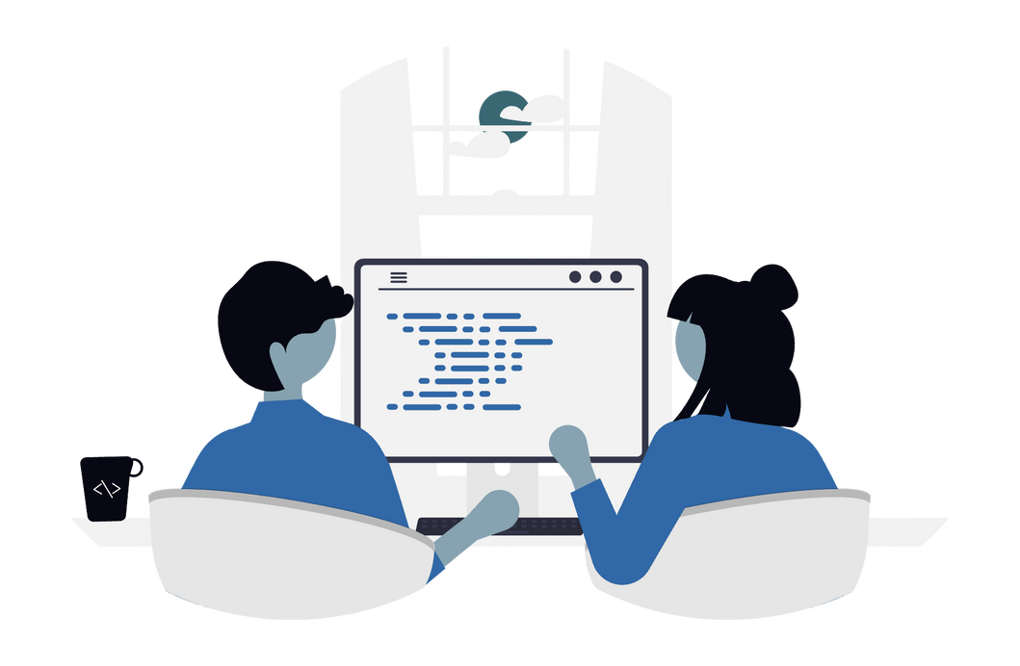
8.
Neglecting Strategic Thinking and Team Development
Block time for strategic planning and learning.
Set up "lunch and learn" sessions where external experts or team members share knowledge.
Show your own learning publicly.

Slide 19

9.
Meeting Vampirism: The Stealth Tax on Cognitive Capital
Replace most status meetings with asynchronous video updates.
Create shared dashboards showing project status, eliminating need for most status meetings.

Slide 20
The 9 Habits
Equating Busyness With Value
Failing to Set, Respect and Model Healthy Boundaries
Promotion Paradox: Rewarding Crisis Over Consistency
Overloading Top Performers
Involving Yourself in Every Decision
The On-Call Illusion: When Availability Becomes Addiction
Building Fragile Engineering Systems
Neglecting Strategic Thinking and Team Development
Meeting Vampirism: The Stealth Tax on Cognitive Capital

Slide 21
Q&A / Thank you!

